Slide 1
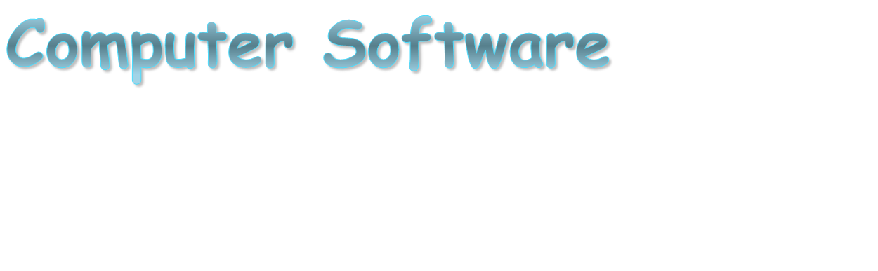
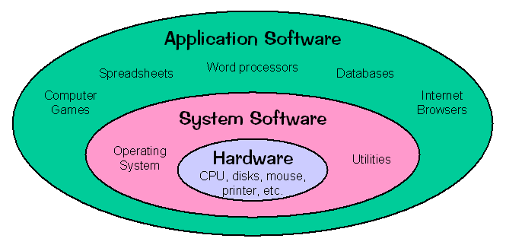

Slide 2
Software & Hardware?
Computer Instructions or data, anything that can be stored electronically is Software.
Hardware is one that is tangible. The storage devices (Hard disk, CD’s etc.,), mouse, keyboard CPU and display devices (Monitor) are Hardware.

Slide 3
Key Concepts
Software licensing
Protection by software vendors to prevent
unauthorized use
Software upgrades
A revised version of software that usually includes
fixes of known problems, plus enhancements to
existing capabilities
Global software support
Software that is distributed around the globe may
require unique support mechanisms due to local
political and economic conditions

Slide 4
Computer software
Software consists of programs and enables a
computer to perform specific tasks, as opposed to
its physical components (hardware) which can only
do the tasks they are mechanically designed for.
It is loaded into a computer's storage (such as
a hard drive, a memory, or RAM). Once the
software is loaded, the computer is able to
execute the software in the Central Processing
Unit (CPU).

Slide 5
Computer software
This involves passing instructions from the
application software, through the system
software, to the hardware which ultimately
receives the instruction as a machine
code. Each instruction causes the computer to
carry out an operation – to move data, carry
out a computation, or alter the control flow of
instructions.

Slide 6
Computer software
Data is typically moved from one place in the memory to another. Sometimes it involves moving data between memory and registers which enables high-speed data access in the CPU.
Instructions may be performed sequentially, conditionally, or iteratively.

Slide 7
Sequential instructions
Sequential instructions are those operations that are performed one after another.

Slide 8
Conditional instructions
They are performed in such a way that different sets of instructions are executed depending on the value(s) of some data. In some languages this is known as an “if statement“.

Slide 9
Iterative instructions
They are performed repetitively and may depend on some data value. This is sometimes called a “loop.“ Often, one instruction may “call“ another set of instructions that are defined in some other program or module. When more than one computer processor is used, instructions may be executed simultaneously.

Slide 10
Types of Software
        System Software
        Programming software
        Application Software
        Open source software (OSS)
        Proprietary software

Slide 11
System Software:
It includes the Operating System and all the
utilities that enable the computer to function.
It refers to any computer software which manages
and controls the hardware so that application
software can perform a task.
Example: Operating Systems, Compiler, Loader,
Linker, Interpreter.

Slide 12
Operating System:
Operating System is a software, which makes a computer to actually work.
It is the software that enables all the programs we use.
The OS organizes and controls the hardware.
OS acts as an interface between the application programs and the machine hardware.
Examples: Windows, Linux, Unix and Mac OS, etc.,

Slide 13
Compiler:
It is a program that reads a program in one language – the source language and translates into an equivalent program in another language – the target language.
Source Languages | Target Languages
‘C’ language | ‘C’ language
‘Pascal’ language | Machine language
FORTRAN language
C++ language
ADA language

Slide 14
Loader:
It is the part of an operating system that is responsible for loading programs into memory, preparing them for execution and then executing them.
The loader is usually a part of the operating system's kernel and usually is loaded at system boot time and stays in memory until the system is rebooted, shut down, or powered off.
In Unix, the loader is the handler for the system call execve().

Slide 15
Linker:
A linker or link editor is a program that takes one or more objects generated by compilers and assembles them into a single executable program.
Linkers can take objects from a collection called a library. The objects are program modules containing machine code and information for the linker.
The linker takes care of arranging the objects in a program's address space.

Slide 16
Interpreter:
It is a computer program that translates and executes instructions written in a computer programming language line-by-line, unit by unit etc.,
An interpreter needs to be able to analyze instructions written in the source language.
Example: Lisp systems, etc.,

Slide 17
Application Software:
Application Software includes programs that do real work for a user.
Example:
Payroll systems, Inventory Control, Manage student database, Word Processor, Spreadsheet and Database Management System etc.,

Slide 18
Word Processors:
It is a tool that helps user in creating, editing, and
printing documents. Word processors will normally have
the following capabilities built into them:
        Spell checking
        Standard layouts for normal documents
        Some characters appearing in bold print, italics, or underlined
        Center lines, make text line up on the left side of the paper, or the right side of the paper
        Save the document so it can be used again
        Print the document.
Examples: WordPerfect and Microsoft Word

Slide 19
Spreadsheets:
The spreadsheet packages are designed to use
numbers and formulas to do calculations with
ease. Examples of spreadsheets include:
        Budgets
        Payrolls
        Grade Calculations
        Address Lists
The most commonly used spreadsheet programs
are Microsoft Excel and Lotus 123.

Slide 20
Graphic Presentations:
The presentation programs can make giving
presentations easier. Other uses include:
        Slide Shows
        Repeating Computer Presentations on a computer monitor
        Using Sound and animation in slide shows
The most recognized graphic presentation
programs are Microsoft PowerPoint and Harvard
Graphics.

Slide 21
Database Management System(DBMS):
A DBMS is a software tool that allows multiple users to store, access, and process data into useful information.
Database programs are designed for these types of applications:
        Membership lists
        Student lists
        Grade reports
        Instructor schedules
All of these have to be maintained so you can find what you need quickly and accurately.
Example:Microsoft Access, dBASE, Oracle.

Slide 22
Open Source Software:
Open source software (OSS) is computer software whose source code is available under a license that permits users to use, change, and improve the software, and to redistribute it in modified or unmodified form.
It is often developed in a public, collaborative manner.
Well-known OSS products are Linux, Netscape/Firefox, Apache , etc.,

Slide 23
Proprietary Software:
Proprietary software (also called non-free software) is software with restrictions on using, copying and modifying as enforced by the proprietor. Restriction on use, modification and copying is achieved by either legal or technical means and sometimes both.
Proponents of proprietary software are Microsoft.
Examples: AutoCAD, Norton Antivirus etc.,

Slide 24
as opposed to
Note the use of
Software consists of programs and enables a computer to perform specific tasks, as opposed to its physical components (hardware) which can only do the tasks they are mechanically designed for.

Slide 25
Unlike
Unlike software, computer hardware encompasses the physical interconnections and devices required to store and execute (or run) the software.

Slide 26
Once
Once the software is loaded, the computer is able to execute the software in the Central Processing Unit (CPU).

Slide 27
in such a way that
Conditional instructions are performed in such a way that different sets of instructions are executed depending on the value(s) of some data.

Slide 28
Consequently
Consequently, large areas of activities (such as playing grand master level chess) formerly assumed to be incapable of software simulation are now routinely programmed.

